Slide 1
¿DO NOTEBOOKS IMPROVE GRADES?
Gabriela García #5
Erica Guerrero #6
11th Preschool Teaching

Slide 2
The use of computers as a teaching tool increased concentration, reinforced motivation and facilitated both the development and the autonomy of students.
Students with laptops write more than average students.
The presence of computers clearly affects the teacher-student relationship.
(Karsenti, 2013)

Slide 3
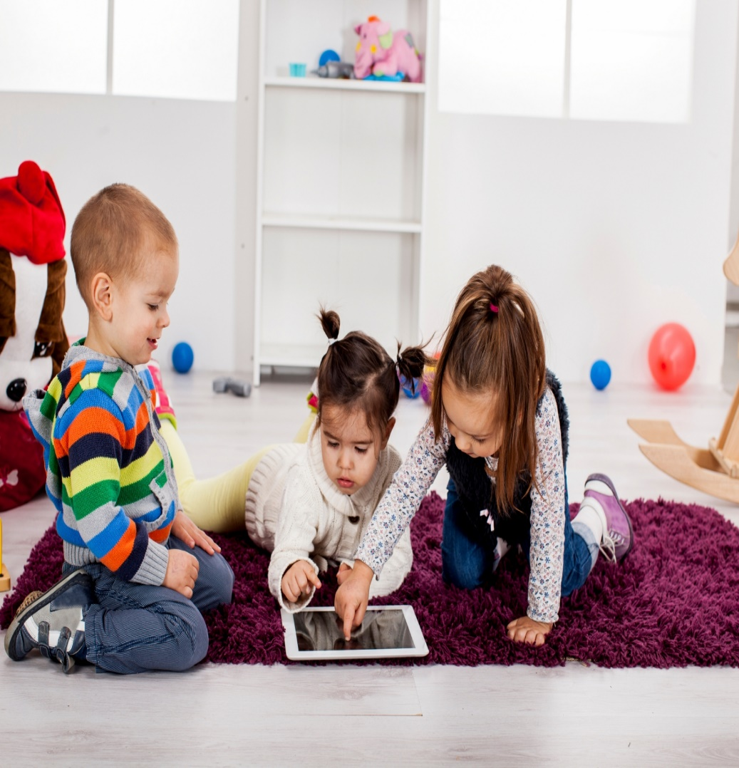
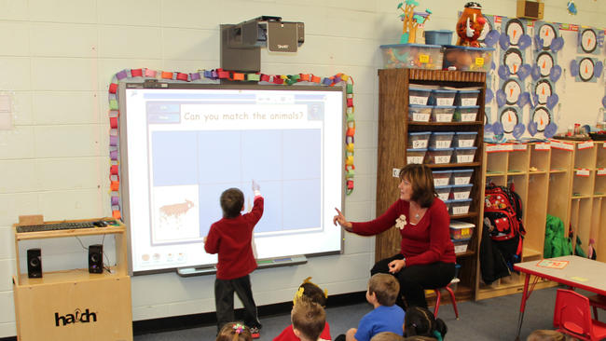

Slide 4
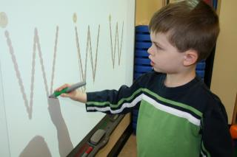

Slide 5
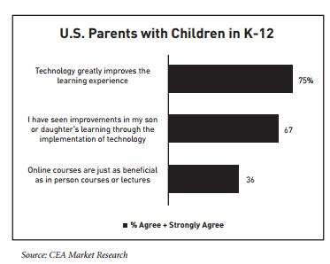

Slide 6
video
https://www.youtube.com/watch?v=IzSNdxsfk0Q
Eric Crouch

