Slide 1
Desuggestopedia Method
“Learning is matter of attitude not aptitude”
Georgi Lozanov
María Olga Alfaro #1
Gabriela García #5
11th Preschool Teaching

Slide 2
CHaracteristics
The classroom is bright and colorful.
The teacher speaks confidently.
The students introduce themselves to the teacher.

Slide 3
How to apply desuggestopedia in your classroom
You need a background music.
Let your students feel comfortable and relaxed.
Present some stories to the students because it can be use as a way of correcting mistakes and practice.
Grammar flashcards.

Slide 4
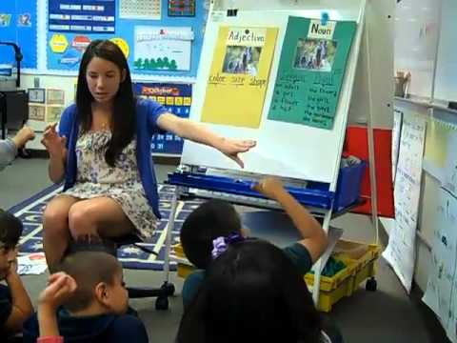

Slide 5
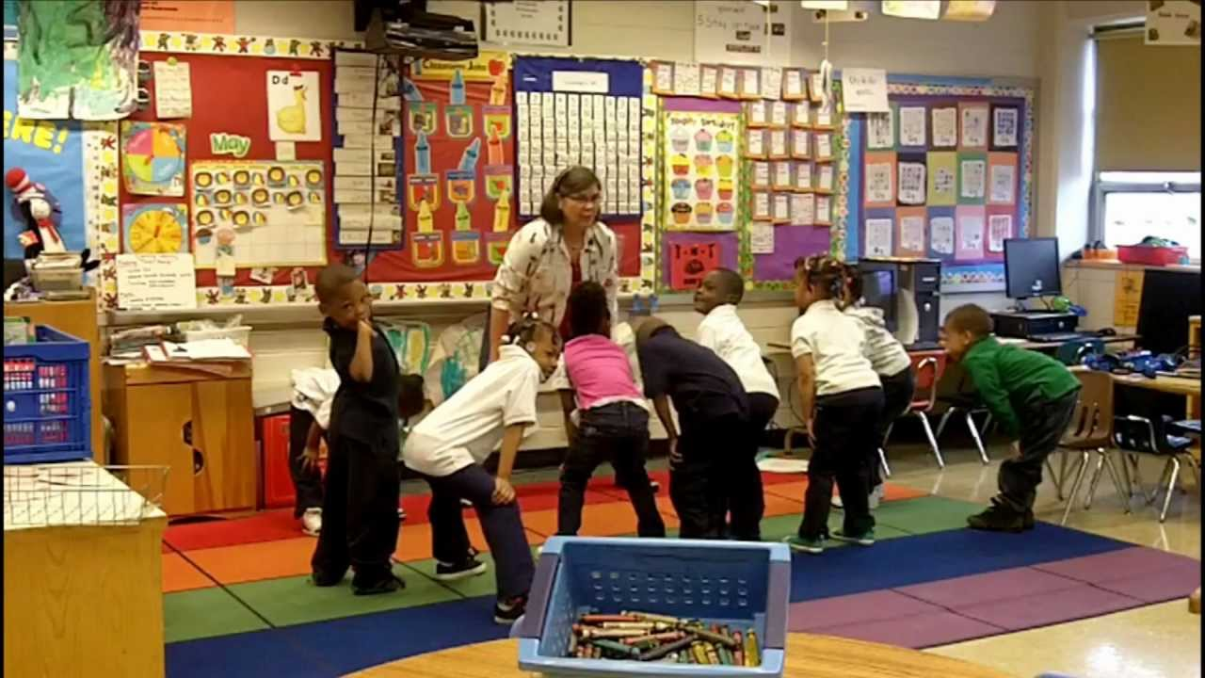

Slide 6
Video
By: Marco Brazil
https://www.youtube.com/watch?v=zl_ppO5zKAI

