Slide 1
Classroom Management
¿What is it?
It’s effective discipline.
It’s being prepared for class.
It’s motivating your students.
¿Why is important?
Classroom management issues are of highest concern for beginning teachers.
¿Why is it different?
Teaching Styles
Personality/Attitudes
Student population.
Not all management strategies are effective for every teacher
Principles
Teach students to manage their own
behavior.
Deal with disruptive behaviors.

Slide 2
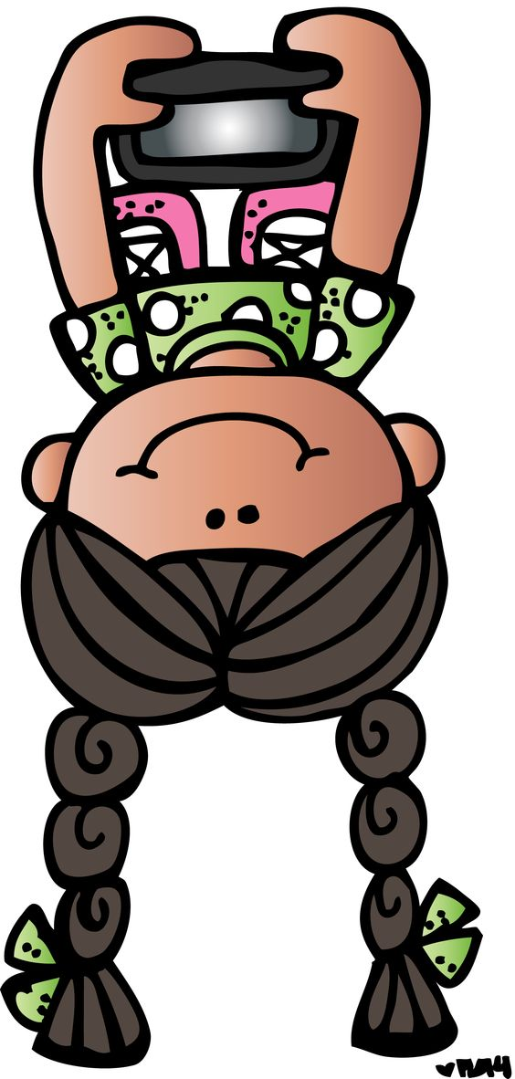
Techniques
Focus attention on entire class.
Learn student
names as
quickly
as possible.
Make sure classroom is comfortable
and safe
Silence can be effective.

Slide 3
Withitness
¿What is it?
Refers to a
teacher’s awareness of what is going on
in the classroom.
A teacher has “withitness” if:
When discipline problems occur, the
teacher consistently takes action to
suppress the misbehavior of exactly
those students who instigated the
Problem.

Slide 4
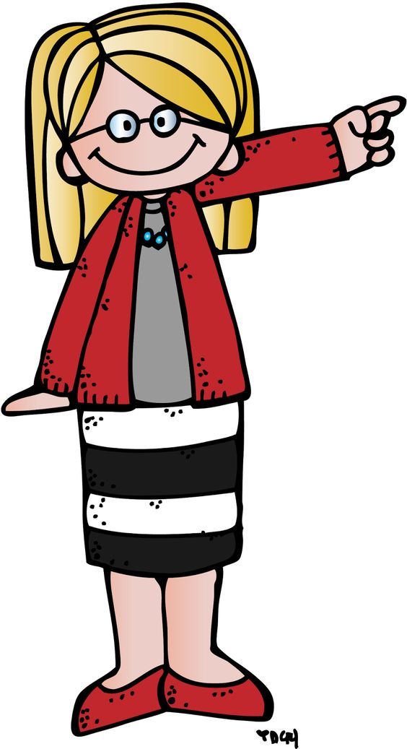
Rules
Classroom Rules For
Conduct
Necessary classroom rules
of conduct
A few rules are easier
to remember
than many rules.
Each rule in a small
set of rules is more
important than
each rule in a large
set of rules.
Secures the safety and comfort of the
learning
environment
Prevents the activities of the class from disturbing other classes.

Slide 5
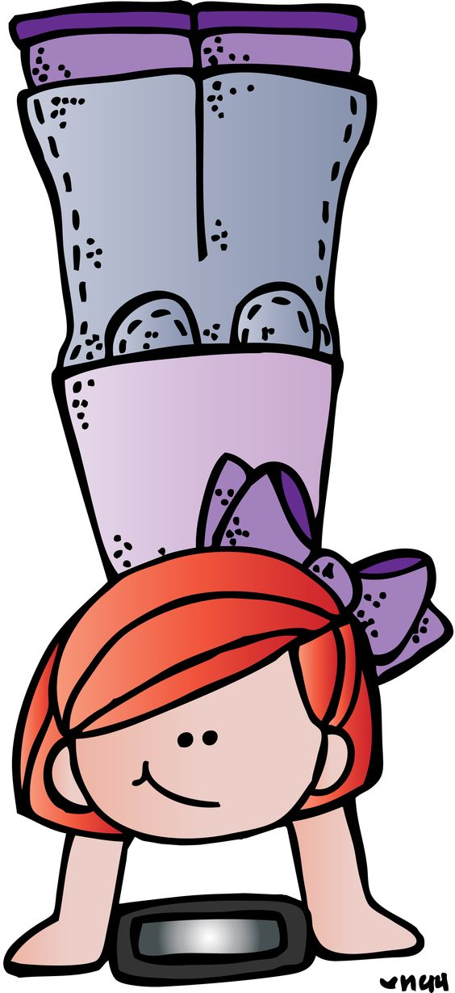
Behavior
Do not tolerate
undesirable behaviors
no matter what the
excuse
Understanding why
a person exhibits a
behavior is no
reason to tolerate it
Functions of
behavior
Attention Seeking Behavior
Attention-seeking students prefer
being punished, admonished, or
criticized to being ignored
Power Seeking Behavior
Power-seeking students attempt to
provoke teachers into a struggle of
wills

Slide 6
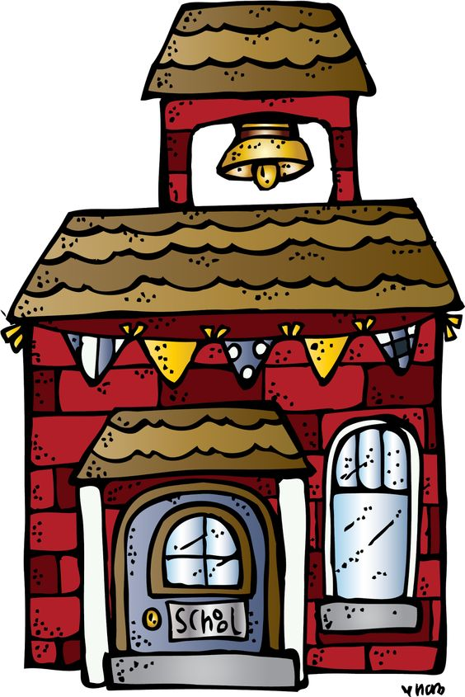
Policies relating directly to students
Attendance/Tardy Policy
Academic/Grading Policies
Alcohol, Tobacco, and Drug Policies
Sexual Harassment Policy
School Policies
CTSO
Travel policies
Fundraising policies
Activity absence policies
Student organization finance policies
Accident reporting procedures
Reporting academic progress
Purchasing guidelines
Substitute teachers
Policies you’ll need to be
aware of as a teacher

